Slide 1

Predictive Modelling and Capacity Optimization for Net-Zero Residential Energy Systems
DISSERTATION PROPOSAL
Department of Computer Science and Engineering
JAWAHARLAL NEHRU TECHNOLOGICAL UNIVERSITY HYDERABAD UNIVERSITY
COLLEGE OF ENGINEERING, SCIENCE AND TECHNOLOGY HYDERABAD
Presented By:
Gandla Sreeshanth
22011P0536
Mentor:
Mr. Gollakota Narasimham
Associate Professor,
CSE Department ,JNTUH

Slide 2
Project Objective
Bridge the critical gap between residential energy demand and weather-driven solar PV supply.
Output the optimal solar panel (kWp) and battery storage (kWh) capacity necessary for a net-zero annual bill.
Utilize predictive modelling and deterministic optimization to ensure accurate and tailored system sizing.

Slide 3
Problem Definition
The challenge of imprecise planning:
Currently, homeowners lack reliable, scientific methods to calculate the precise solar and battery capacity required to completely eliminate their electricity bills.
The industry's heavy reliance on generic "rules-of-thumb" for system sizing frequently leads to costly over-investments or severely under-performing residential setups.

Slide 4
Survey of Existing Systems
Solar Integration: Katsanevakis et al. (2024) emphasizes predicting household usage and solar generation for highly efficient energy utilization.
Surplus Automation: This framework switches on specific electrical appliances during predicted energy surpluses to effectively manage local power.
Weather Context: Hewage et al. (2026) highlights integrating weather variables with temporal autocorrelation for fine-grained demand forecasting.

Slide 5
Survey of Existing Systems
Economic Impact: Günther et al. (2019) analyzes how distinct tariff designs influence homeowner investments in residential PV and battery setups.
Investment Drivers: Feed-in tariffs significantly incentivize or restrict capacity investments based on external market conditions.
Current Limitations: Households currently rely on generic rules-of-thumb instead of precise mathematical tools to calculate net-zero capacity needs.

Slide 6
Dataset Overview
The complete dataset consists of:
100 residential homes
70,128 time steps per home
7,012,800 home-level records
70,128 synchronized regional timestamps
30-minute temporal resolution

Slide 7
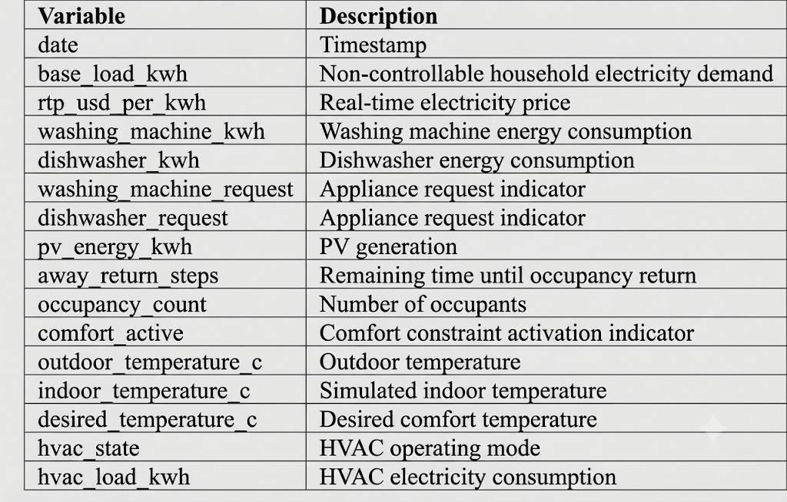
Dataset Overview

Slide 8






Data Composition
Regional Layer
Household Scenarios
Thermal Dynamics
External shared signals including NSRDB Solar irradiance, meteorological variables for Sacramento, and CAISO electricity prices.
Heterogeneous tracking of base-load kWh, individual PV generation capabilities, shiftable appliances, and occupancy characteristics.
Indoor temperature evolution utilizing heterogeneous reduced-order RC thermal models to generate consistent feedback for HVAC control.

Slide 9
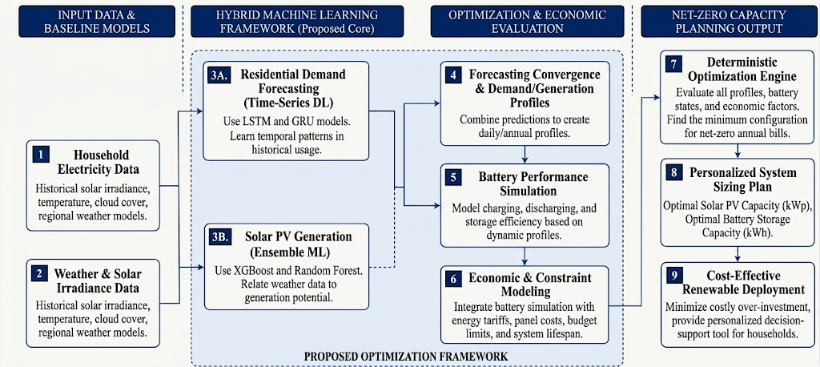
System Architecture

Slide 10




Project Roadmap
Nov - Dec 2026
Mar - Apr 2027
Phase 2: Architecture design, development, and training of the hybrid ML models on the 2020-2021 split.
Phase 4: Extensive system validation on 2023 unseen test data, and final project submission.
Aug - Oct 2026
Jan - Feb 2027
Phase 1: Comprehensive literature review, dataset ingestion, and requirement gathering.
Phase 3: Integration of the deterministic optimization engine and running battery simulations (2022 Eval).

Slide 11
Conclusion
This research bridges the gap between residential energy demand and solar supply by replacing generic rules-of-thumb with a personalized, data-driven framework. By integrating time-series deep learning and ensemble machine learning models, the system accurately forecasts household electricity consumption alongside weather-driven photovoltaic generation. Ultimately, this deterministic optimization tool determines the exact solar and battery storage capacity needed for a net-zero annual bill, preventing costly over-investments and accelerating cost-effective renewable energy deployment.

Slide 12
Key References
Aistis Raudys and Julius Gaidukevicius; Forecasting Solar Energy Generation and Household Energy Usage for Efficient Utilisation, MDPI, Energies 2024
Pradeep Hewage; Marcello Trovati; Ella Pereira; Ardhendu Behera; Deep learning‑based effective fine‑grained weather forecasting model, Pattern Analysis and Applications (2021) 24:343–366
Dataset Source: A Hybrid Benchmark Dataset for Multi-Home Residential Energy Management under Heterogeneous Building and Energy Conditions.
NREL NSRDB (2024). National Solar Radiation Database Data Viewer. Used for regional solar-resource modeling.

Slide 13
THANK YOU

